Slide 1


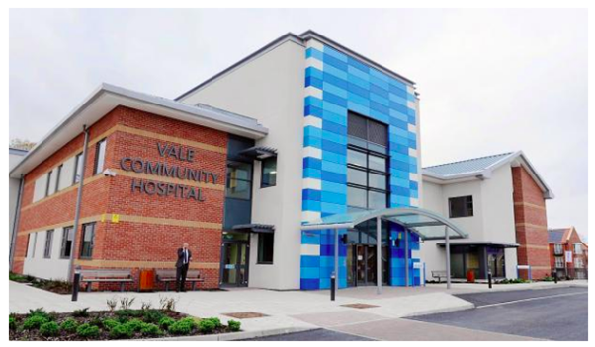




ICIC2026
Community Hospitals and Community Hubs Integrated Care in Changing Models of Community Services in England
“
Dr Helen Tucker
Jo Posnette RN Dip.N MA
Community Hospitals Association
info@communityhospitals.net
www.communityhospitals.org.uk

Slide 2
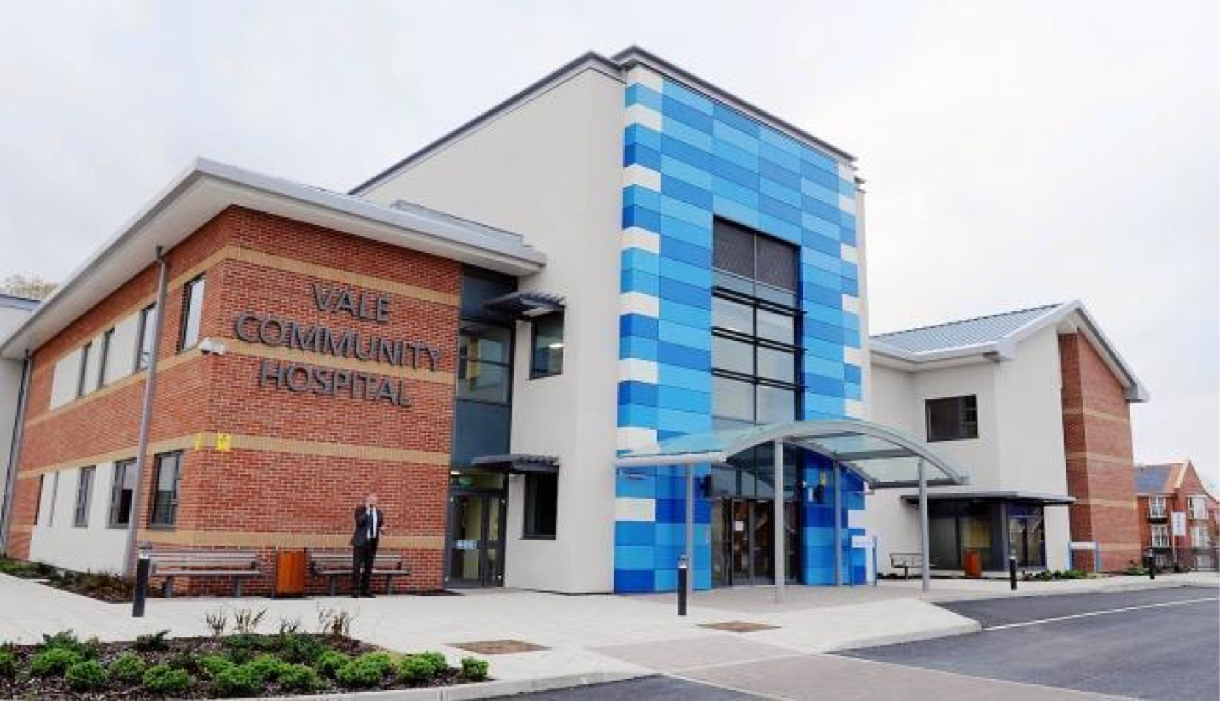
What is a Community Hospital?
Small local hospital
Led by community based staff
Typically rural or coastal
Provide “Cradle to Grave”
Person-Centred Care
Provide Intermediate care
First community hospital 160 years ago
Established and sustained through strong community support
The Vale Hospital, Gloucestershire, England

Slide 3


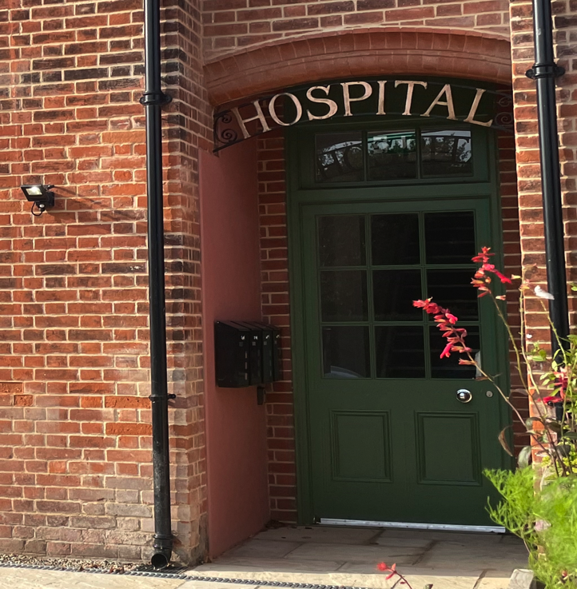
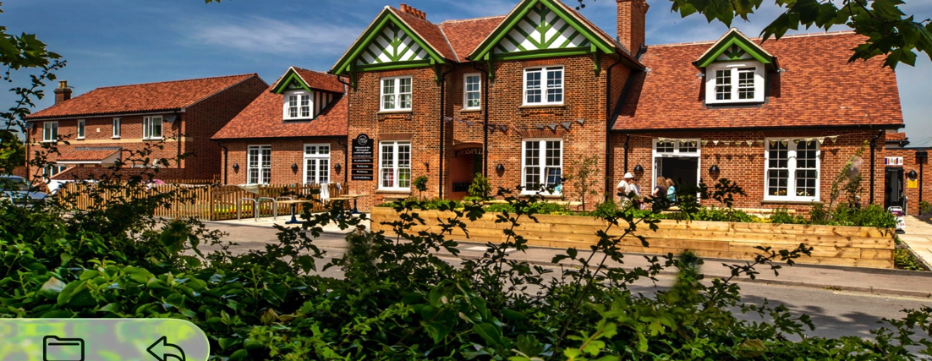
“The National Voice for Community Hospitals”
Website http://www.communityhospitals.org.uk/

Slide 4

Community Hospitals International Networking
Japan
Singapore
UK
Italy
Sweden
Canada
Spain
Webinar Registered: 31 countries and 263 people

Slide 5
Community Hospitals Association
CHA:
A membership organisation established 55 years ago promoting Community Hospitals
CHA Database:
CHA maintains unique database - No National Definition or National Strategy
Department of Health commissioned a Profiling Study from CHA in 2008
CHA Research:
The Value of Community Hospitals - University of Birmingham
Efficiency and Effectiveness of Community Hospitals - University of Leeds
Davidson, D., Ellis Paine, A., Glasby,J., Williams, I., Tucker H., et al 2019 Analysis of the profile, characteristics, patient experience and community value of community hospitals: a multi-method study. January 2019 DOI: 10.3310/hsdr07010
Gladman J, Buckell J, Young J, Smith A, Saggu, S , Godfrey M, Enderby P, Teale E, Longo R, Gannon B. Holditch C, Eardley H., Tucker H. (2017) “Understanding the Models of Community Hospital rehabilitation Activity (MoCHA): a mixed-methods study” BMJ Open 2017;7:e010483. doi: 10.1136/bmjopen-2015-010483

Slide 6

Our Approach
Mixed Method
Updated Profiling Study 2008
Sample of 50% Community Hospitals
Triangulated Data
Ongoing Validation
Case Studies

Slide 7

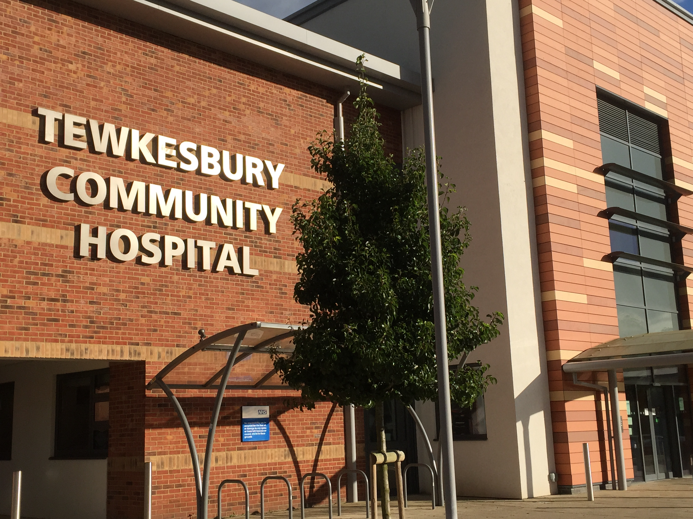

Models of Community Hospitals in the UK
Community Hospital
Classic community hospital with beds and clinical services offering intermediate care
Tewkesbury Community Hospital, Gloucestershire
Community Health and Wellbeing Hub
A Centre for health, social care, health promotion welfare and community support. Within a community hospital that no longer offers bed-based care
Seachange Devon
Previously Budleigh Salterton Community Hospital

Slide 8
Community Hospital Services
In-Patient Wards
Rehabilitation
Sub-Acute
End of Life Care
Urgent Care
Minor Injuries
Minor iIlness
Rehabilitation
Physiotherapy
OT etc
Clinics
Consultant clinics
Community clinics
Day Treatment
Surgery
Renal Dialysis
Diagnostics
Xray & Ultra Sound
ECG
Pathology
Facilities
Meeting rooms for community groups and voluntary agencies
Base for community teams

Slide 9

Community Hospitals Integrating Care
Primary Care
& Community Hospital
Multidisciplinary Teams
Health and Social Care
Acute Care
& Community Hospital
Tucker, H. (2013), "Discovering integrated care in community hospitals", Journal of Integrated Care, Vol. 21 No. 6, pp. 336-346. https://doi.org/10.1108/JICA-10-2013-0038

Slide 10
Community Health and Wellbeing Hub Services
Health & Wellbeing
Pain Management Class
Falls Prevention
Parkinsons Wellbeing
Social & Wellbeing
Gardening for Health
Health and Nature Walks
Singing for Wellbeing
Community Café
Meeting Place for community
Affordable Meals
Training & Employment
Library
Health Education
Information & Resources
Gym
Inclusive Facility
Community Support Groups
Stoma Support
Carers Drop In
Bereavement Support
Facilities
Meeting rooms for community groups and voluntary agencies
Office base for NHS community teams

Slide 11

Community Health and Wellbeing Hubs
Integrating Care
Community Hub & NGOs
Voluntary Agencies
Community Hub
& Social Care
Community Hub & Independent Practitioners
Community Hub
& Community

Slide 12
Changes in Community Hospital Model
1998
Community Hospital 100%
Community Hub 0%
2008
Community Hospital 95%
Community Hub 5%
2026 (n=176 sample 50%)
Community Hospital 63%
Community Hub 37%

Slide 13
Comparing Features of Community Hospitals and Community Health and Wellbeing Hubs
Community Hospital
Clinical care – local accessible healthcare
Intermediate care - rehabilitation, end of life care etc
Diagnostic and treatment services
Open 24/7 365 days a year
Community Health and Wellbeing Hub
Health Promotion, illness prevention
Social Prescribing, welfare, social support
Open daily but closed at night (and maybe weekends)

Slide 14
Alignment with National Policy
From Hospital to Community - Care Closer to Home
From sickness to prevention
Supporting communities in self-care
Focus on neighbourhoods – defined communities
A role in demand management – minimising inappropriate use of acute hospitals

Slide 15

Understanding Integrated Care in Changing Community Hospital Models
Promote more research
Encourage analysis of case studies
Incorporate the experience of service users, staff and communities
Further validation with members at national conference

Slide 16


CHA National Conference

